Slide 1
Logical operators

Slide 2
Outline
In this lesson, we will:
See the need for asking if more than one condition is satisfied
The unit pulse function
Describe the binary logical and and or operators
Introduce truth tables
Describe chaining numerous logical expressions
Describe short-circuit evaluation
Describe the unary logical negation (not)

Slide 3
Background
We have seen six comparison operators
Three complementary pairs
== != < >= > <=
Problem:
What if more than one condition is required?
What if two conditions result in the same consequent?
What if we require that a condition must be false?

Slide 4
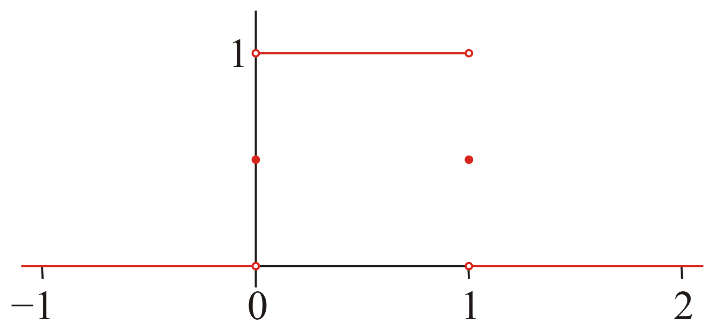
The unit pulse
Suppose we want to implement the function:
This function has an integral (area under the curve) equal to 1

Slide 5
The unit pulse
We could implement this function as follows:
double unit( double x );
double unit( double x ) {
if ( x < 0.0 ) {
return 0.0;
} else if ( x == 0.0 ) {
return 0.5;
} else if ( x < 1.0 ) {
return 1.0;
} else if ( x == 1.0 ) {
return 0.5;
} else {
return 0.0;
}
}

Slide 6
The unit pulse
Can we implement this using two consequents and one alternative?
double unit( double x );
double unit( double x ) {
if ( Condition A ) {
return 0.0;
} else if ( Condition B ) {
return 0.5;
} else {
return 1.0;
}

Slide 7
Logical operators
In English, we would simply say that the result is
0 if either x < 0 or x > 1,
0.5 if either x = 0 or x = 1, and
1 if both x > 0 and x < 1

Slide 8
Logical operators
In C++, there are two logical binary operators
They take two Boolean values (bool) and return a Boolean value
The or operator || returns true if either operands is true
The and operator && returns true if both operators are true
Consequent | Conditions | C++
0.0 | or | (x < 0) || (x > 1)
0.5 | or | (x == 0) || (x == 1)
1.0 | and | (x > 0) && (x < 1)

Slide 9
Logical operators
Thus, we may implement the function as:
#include <cassert>
double unit( double x );
double unit( double x ) {
if ( (x < 0) || (x > 1) ) {
return 0.0;
} else if ( (0 == x) || (1 == x) ) {
return 0.5;
} else {
assert( (x > 0) && (x < 1) );
return 1.0;
}
}

Slide 10
Maximum of three
We can now implement the maximum-of-three function as follows:
double max( double x, double y, double z );
double max( double x, double y, double z ) {
if ( (x >= y) && (x >= z) ) {
// 'x' is the maximum if it is greater than or equal
// to 'y' and greater than or equal to 'z'
return x;
} else if ( y >= z ) {
// Now, 'y' is the maximum if 'y' is greater than or
// equal to 'z'
// - if 'y' was not greater than 'x', the first
// condition would have been true
return y;
} else {
return z;
}
}

Slide 11
Truth tables
We know that the logical or operator || is true if either operand is true
It is false if both operands are false
We know that the logical and operator && is true if both operand are true
It is false if either operands is false
To display this visually, we use a truth table

Slide 12
Truth tables
In elementary school, you saw addition and multiplication tables:
Given two operands, the table gave the result of the operation
+ | 0 | 1 | 2 | 3 | 4 | 5 | 6 | 7 | 8 | 9
0 | 0 | 1 | 2 | 3 | 4 | 5 | 6 | 7 | 8 | 9
1 | 1 | 2 | 3 | 4 | 5 | 6 | 7 | 8 | 9 | 10
2 | 2 | 3 | 4 | 5 | 6 | 7 | 8 | 9 | 10 | 11
3 | 3 | 4 | 5 | 6 | 7 | 8 | 9 | 10 | 11 | 12
4 | 4 | 5 | 6 | 7 | 8 | 9 | 10 | 11 | 12 | 13
5 | 5 | 6 | 7 | 8 | 9 | 10 | 11 | 12 | 13 | 14
6 | 6 | 7 | 8 | 9 | 10 | 11 | 12 | 13 | 14 | 15
7 | 7 | 8 | 9 | 10 | 11 | 12 | 13 | 14 | 15 | 16
8 | 8 | 9 | 10 | 11 | 12 | 13 | 14 | 15 | 16 | 17
9 | 9 | 10 | 11 | 12 | 13 | 14 | 15 | 16 | 17 | 18
× | 0 | 1 | 2 | 3 | 4 | 5 | 6 | 7 | 8 | 9
0 | 0 | 0 | 0 | 0 | 0 | 0 | 0 | 0 | 0 | 0
1 | 0 | 1 | 2 | 3 | 4 | 5 | 6 | 7 | 8 | 9
2 | 0 | 2 | 4 | 6 | 8 | 10 | 12 | 14 | 16 | 18
3 | 0 | 3 | 6 | 9 | 12 | 15 | 18 | 21 | 24 | 27
4 | 0 | 4 | 8 | 12 | 16 | 20 | 24 | 28 | 32 | 36
5 | 0 | 5 | 10 | 15 | 20 | 25 | 30 | 35 | 40 | 45
6 | 0 | 6 | 12 | 18 | 24 | 30 | 36 | 42 | 48 | 54
7 | 0 | 7 | 14 | 21 | 28 | 35 | 42 | 49 | 56 | 63
8 | 0 | 8 | 16 | 24 | 32 | 40 | 48 | 56 | 64 | 72
9 | 0 | 9 | 18 | 27 | 36 | 45 | 54 | 63 | 72 | 81

Slide 13
Truth tables
With only two possible values of the operands, these truth tables are much simpler:
&& | true | false
true | true | false
false | false | false
|| | true | false
true | true | true
false | true | false

Slide 14
Truth tables
An alternate form is to consider all values of the operands:
x | y | x && y | x || y
true | true | true | true
true | false | false | true
false | false | false | false
false | true | false | true

Slide 15
A reminder…
Just to remind you, however, the result of a logical operator is simply 0 or 1:
// All these print '1':
std::cout << ((3 < 4) && (4 < 5) ) << std::endl;
std::cout << ((6 > 12) || (4 <= 5) ) << std::endl;
std::cout << ((3 == 3) || (5 > 0) ) << std::endl;
std::cout << ((3 <= 4) || (6 >= 15)) << std::endl;

Slide 16
Multiple conditions that may be true
If you have four conditions, any of which need be true, parentheses are not necessary:
if ( (1st-cond) || (2nd-cond) || (3rd-cond) || (4th-cond) ) {
// Do something...
}
Like addition, logical or is associative:
(a + b) + c == a + (b + c)
(a || b) || c == a || (b || c)
If any one condition is true, then
(1st-cond) || (2nd-cond) || (3rd-cond) || (4th-cond)
evaluates to true
If all conditions are false, the logical expression evaluates to false

Slide 17
Multiple conditions that must be true
If you have four conditions, all of which must be true, you need only parenthesize the operands
if ( (1st-cond) && (2nd-cond) && (3rd-cond) && (4th-cond) ) {
// Do something...
}
Like addition and multiplication,
both logical or and logical and are associative
If all conditions are true, then
(1st-cond) && (2nd-cond) && (3rd-cond) && (4th-cond)
evaluates to true
If even one condition is false, the logical expression evaluates to false

Slide 18
Multiple conditions
Note that you may combine both logical operators, but you must be clear what you mean:
(x == 0) || ((x <= 2) && (x >= 1))
is very different from
((x == 0) || (x <= 2)) && (x >= 1)
The first is true if x is 0 or x is in the closed interval [1, 2]
The second is true only if x is in the closed interval [1, 2]
If you leave it as
(x == 0) || (x <= 2) && (x >= 1)
the compiler will decide, and programmers will be left guessing

Slide 19
Short-circuit evaluation
Consider these logical expressions:
(x < -10) || (x > 10)
(x < -10) || ((x > -1) && (x < 1)) || (x > 10)
Suppose that 'x' has the value -100
The first comparison operation returns true
Is there is any reason to even bother testing the others?
No: the result of true || any-other-conditions must be true
This is referred to as short-circuit evaluation

Slide 20
Short-circuit evaluation
Suppose now that 'x' has the value 0:
(x < -10) || (x > 10)
(x < -10) || ((x > -1) && (x < 1)) || (x > 10)
The first condition is false, and
In the first example, (x > 10) is false and it is the last condition, so the expression is false
In the second example, ((x > -1) && (x < 1)) is true, so the entire logical expression is true
There is no need at this point to evaluate (x > 10)
Even though it is false, the entire expression is still true

Slide 21
Short-circuit evaluation
Similarly, consider
(x > -10) && (x < 10)
(x > -10) && ((x < -1) || (x > 1)) && (x < 10)
Suppose that 'x' has the value -100
The first comparison operation returns false
Is there any reason to even bother testing the others?
No: the result of false && any-other-conditions must be false

Slide 22
Short-circuit evaluation
Suppose now that 'x' has the value 0:
(x > -10) && (x < 10)
(x > -10) && ((x < -1) || (x > 1)) && (x < 10)
The first condition is true, and
In the first example, (x < 10) is true and it is the last condition, so the expression is true
In the second example, ((x < -1) || (x > 1)) is false, so the entire logical expression is false
There is no need at this point to evaluate (x < 10)
Even though it is true, the entire expression is still false

Slide 23
Short-circuit evaluation
These functions have equivalent logical expressions:
int f( int x ) {
if ( ((x >= -1) && (x <= 1)) || (x > 10) || (x < -10) ) {
return -1;
} else {
return 1;
}
}
int g( int x ) {
if ( (x < -10) || (x > 10) || ((x <= 1) && (x >= -1)) ) {
return -1;
} else {
return 1;
}
}
When do they stop evaluating when the argument passed is:
-12 -5 -1 7 15

Slide 24
Logical negation
Suppose we want to print a message if some number is not divisible by 13:
int print_good_luck( int n );
int print_good_luck( int n ) {
if ( is_divisible( n, 13 ) ) {
// Do nothing
} else {
std::cout << "Good choice!" << std::endl;
}
}

Slide 25
Logical negation
Verbally, you would simply say: “If n is not divisible by 13, …”
We can do this in C++ by using the unary logical not operator !:
int print_good_luck( int n );
int print_good_luck( int n ) {
if ( !is_divisible( n, 13 ) ) {
std::cout << "Good choice!" << std::endl;
}
}
An alternative is:
if ( is_divisible( n, 13 ) == false ) {

Slide 26
Logical negation
If a Boolean value is true, its negation is false, and vice versa
x | !x
true | false
false | true

Slide 27
Logical negation
The following Boolean-valued statements are equivalent¹:
x is not equal to 1 It is not true that x is equal to 1
(x != 1) !(x == 1)
x is greater than 0 It is not true that x is less than or equal to 0
(x > 0) !(x <= 0)
x is between –1 and 1 It is not true that x is less than –1 or greater
than 1
(x >= -1) && (x <= 1) !((x < -1) || (x > 1))
x – y when divided by 2 has a It is not true that x – y when divided by 2
remainder of 0 has a remainder of 1
((x - y) % 2) == 0 !(((x - y) % 2) == 1)
¹If the operands are the same, the result is the same.

Slide 28
Logical negation
The behavior of these two conditional statements are equivalent:
if ( some-condition ) {
// Do something
} else {
// Do something completely different
}
if ( !some-condition ) {
// Do something completely different
} else {
// Do something
}

Slide 29
Logical negation
Once again, all the unary logical not operator does is change the value of true (that is, 1) to false (0) and vice versa
void check( int n ) {
std::cout << !(n == 0) << std::endl;
std::cout << (n != 0) << std::endl;
std::cout << !(n >= 1) << std::endl;
std::cout << (n < 1) << std::endl;
std::cout << !((n == 0) || (n >= 1)) << std::endl;
std::cout << ((n != 0) && (n < 1)) << std::endl;
}

Slide 30
Decision making
Why do we include these operators?
The literal logical values true and false together with operations such as and, or and not are sufficient to define Boolean logic
In 1938, Claude Shannon wrote his master’s thesis where he demonstrated that the behavior of relays can be modelled by Boolean logic
A relay is a switch that can be turned on or off
Usually with an electromagnet
Transistors are excellent solid-state approximations of switches
Their behavior can still be modelled by Boolean logic

Slide 31
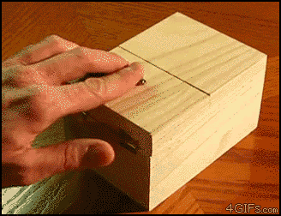
One final aside…
In Claude Shannon’s master’s thesis, written in 1937 when he was 21-years old, he demonstrated that Boolean algebra was sufficient to construct any logical, numerical relationship
He founded information theory
Shannon's maxim: “The enemy knows the system”
He also invented the ultimate machine:

Slide 32
Summary
Following this lesson, you now:
Understand that two or more conditions can be chained together
With a logical and (&&), all must be true for the result to be true
With a logical or (||), one must be true for the result to be true
Are familiarized with truth tables
Understand the idea of short-circuit evaluation
As soon as one condition is false in a chain of logical ands, we’re done: the result must be false
As soon as one condition is true in a chain of logical ors, we’re done: the result must be true
Understand that logical negation switches between true and false

Slide 33
References
[1] No references?

Slide 34



Colophon
These slides were prepared using the Georgia typeface. Mathematical equations use Times New Roman, and source code is presented using Consolas.
The photographs of lilacs in bloom appearing on the title slide and accenting the top of each other slide were taken at the Royal Botanical Gardens on May 27, 2018 by Douglas Wilhelm Harder. Please see
https://www.rbg.ca/
for more information.

Slide 35
Disclaimer
These slides are provided for the ece 150 Fundamentals of Programming course taught at the University of Waterloo. The material in it reflects the authors’ best judgment in light of the information available to them at the time of preparation. Any reliance on these course slides by any party for any other purpose are the responsibility of such parties. The authors accept no responsibility for damages, if any, suffered by any party as a result of decisions made or actions based on these course slides for any other purpose than that for which it was intended.

